Slide 1

Winter program-Software engineering
Back to Litang
Mengru Wang
Haoran Zhang
Zhenxiang Xiong
Runhui Long

Slide 2
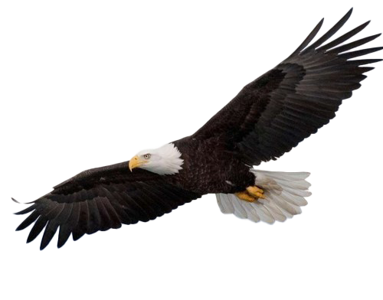
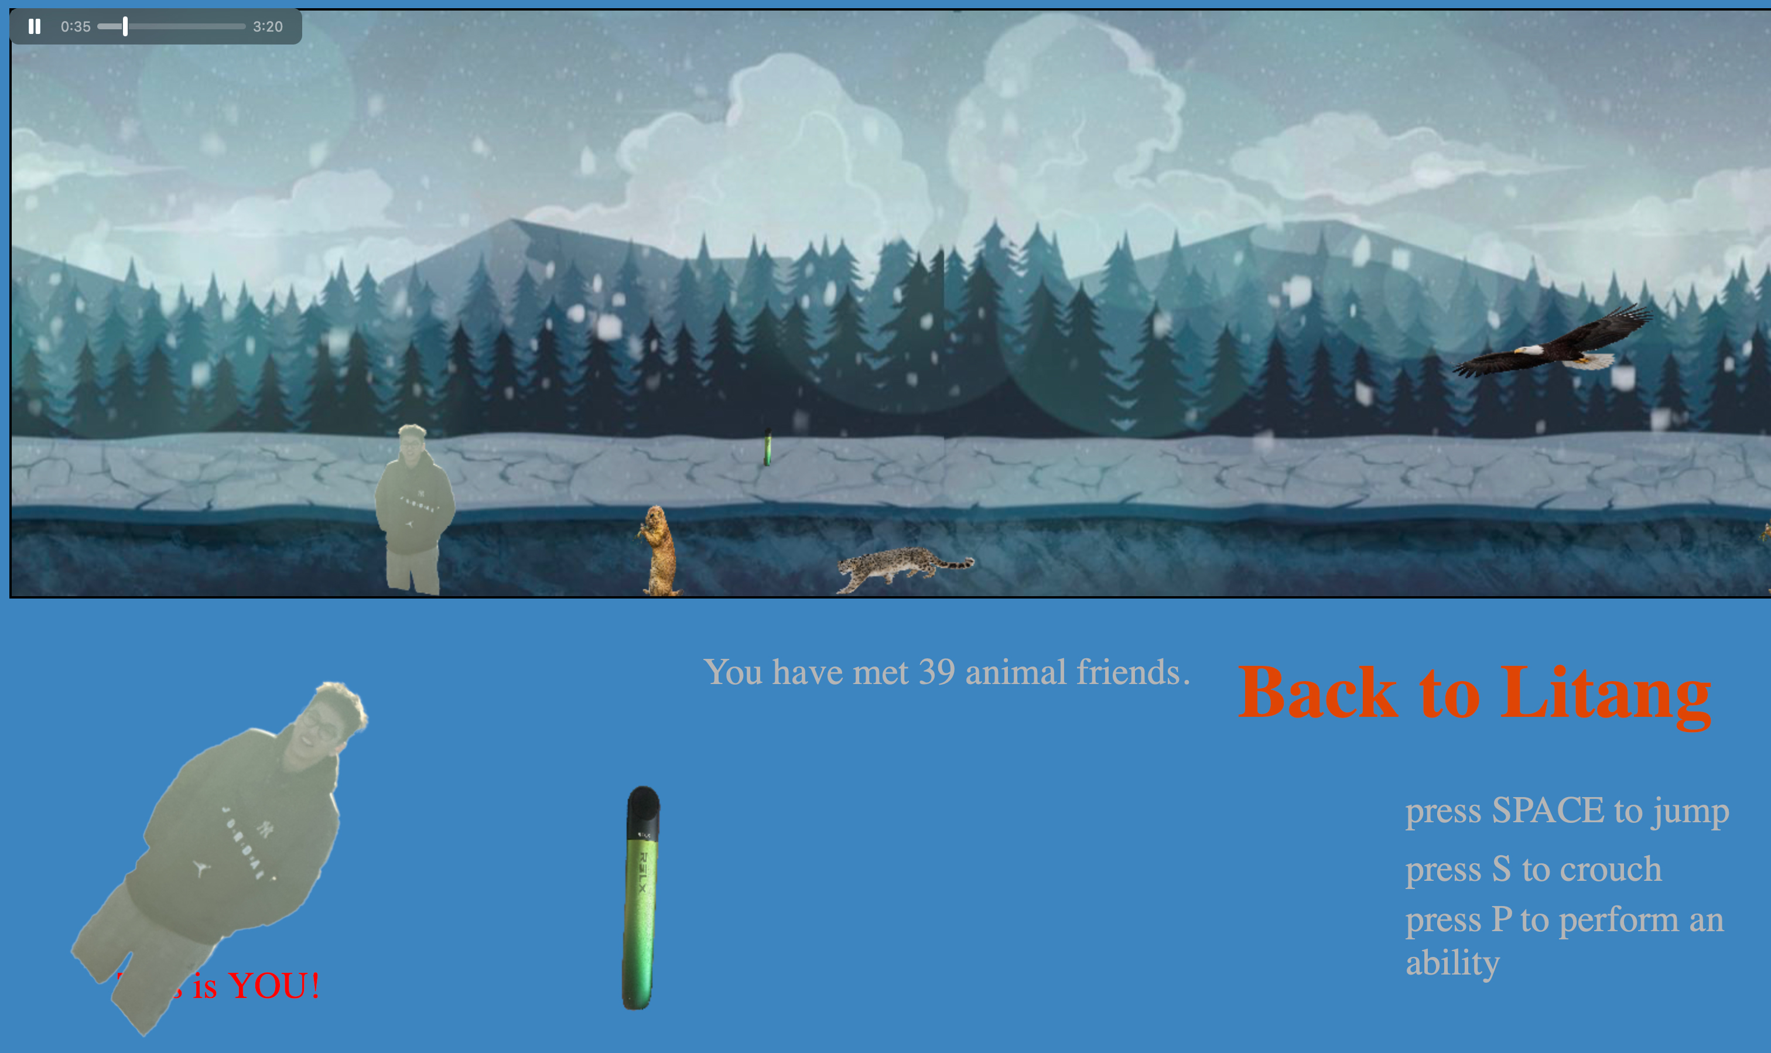
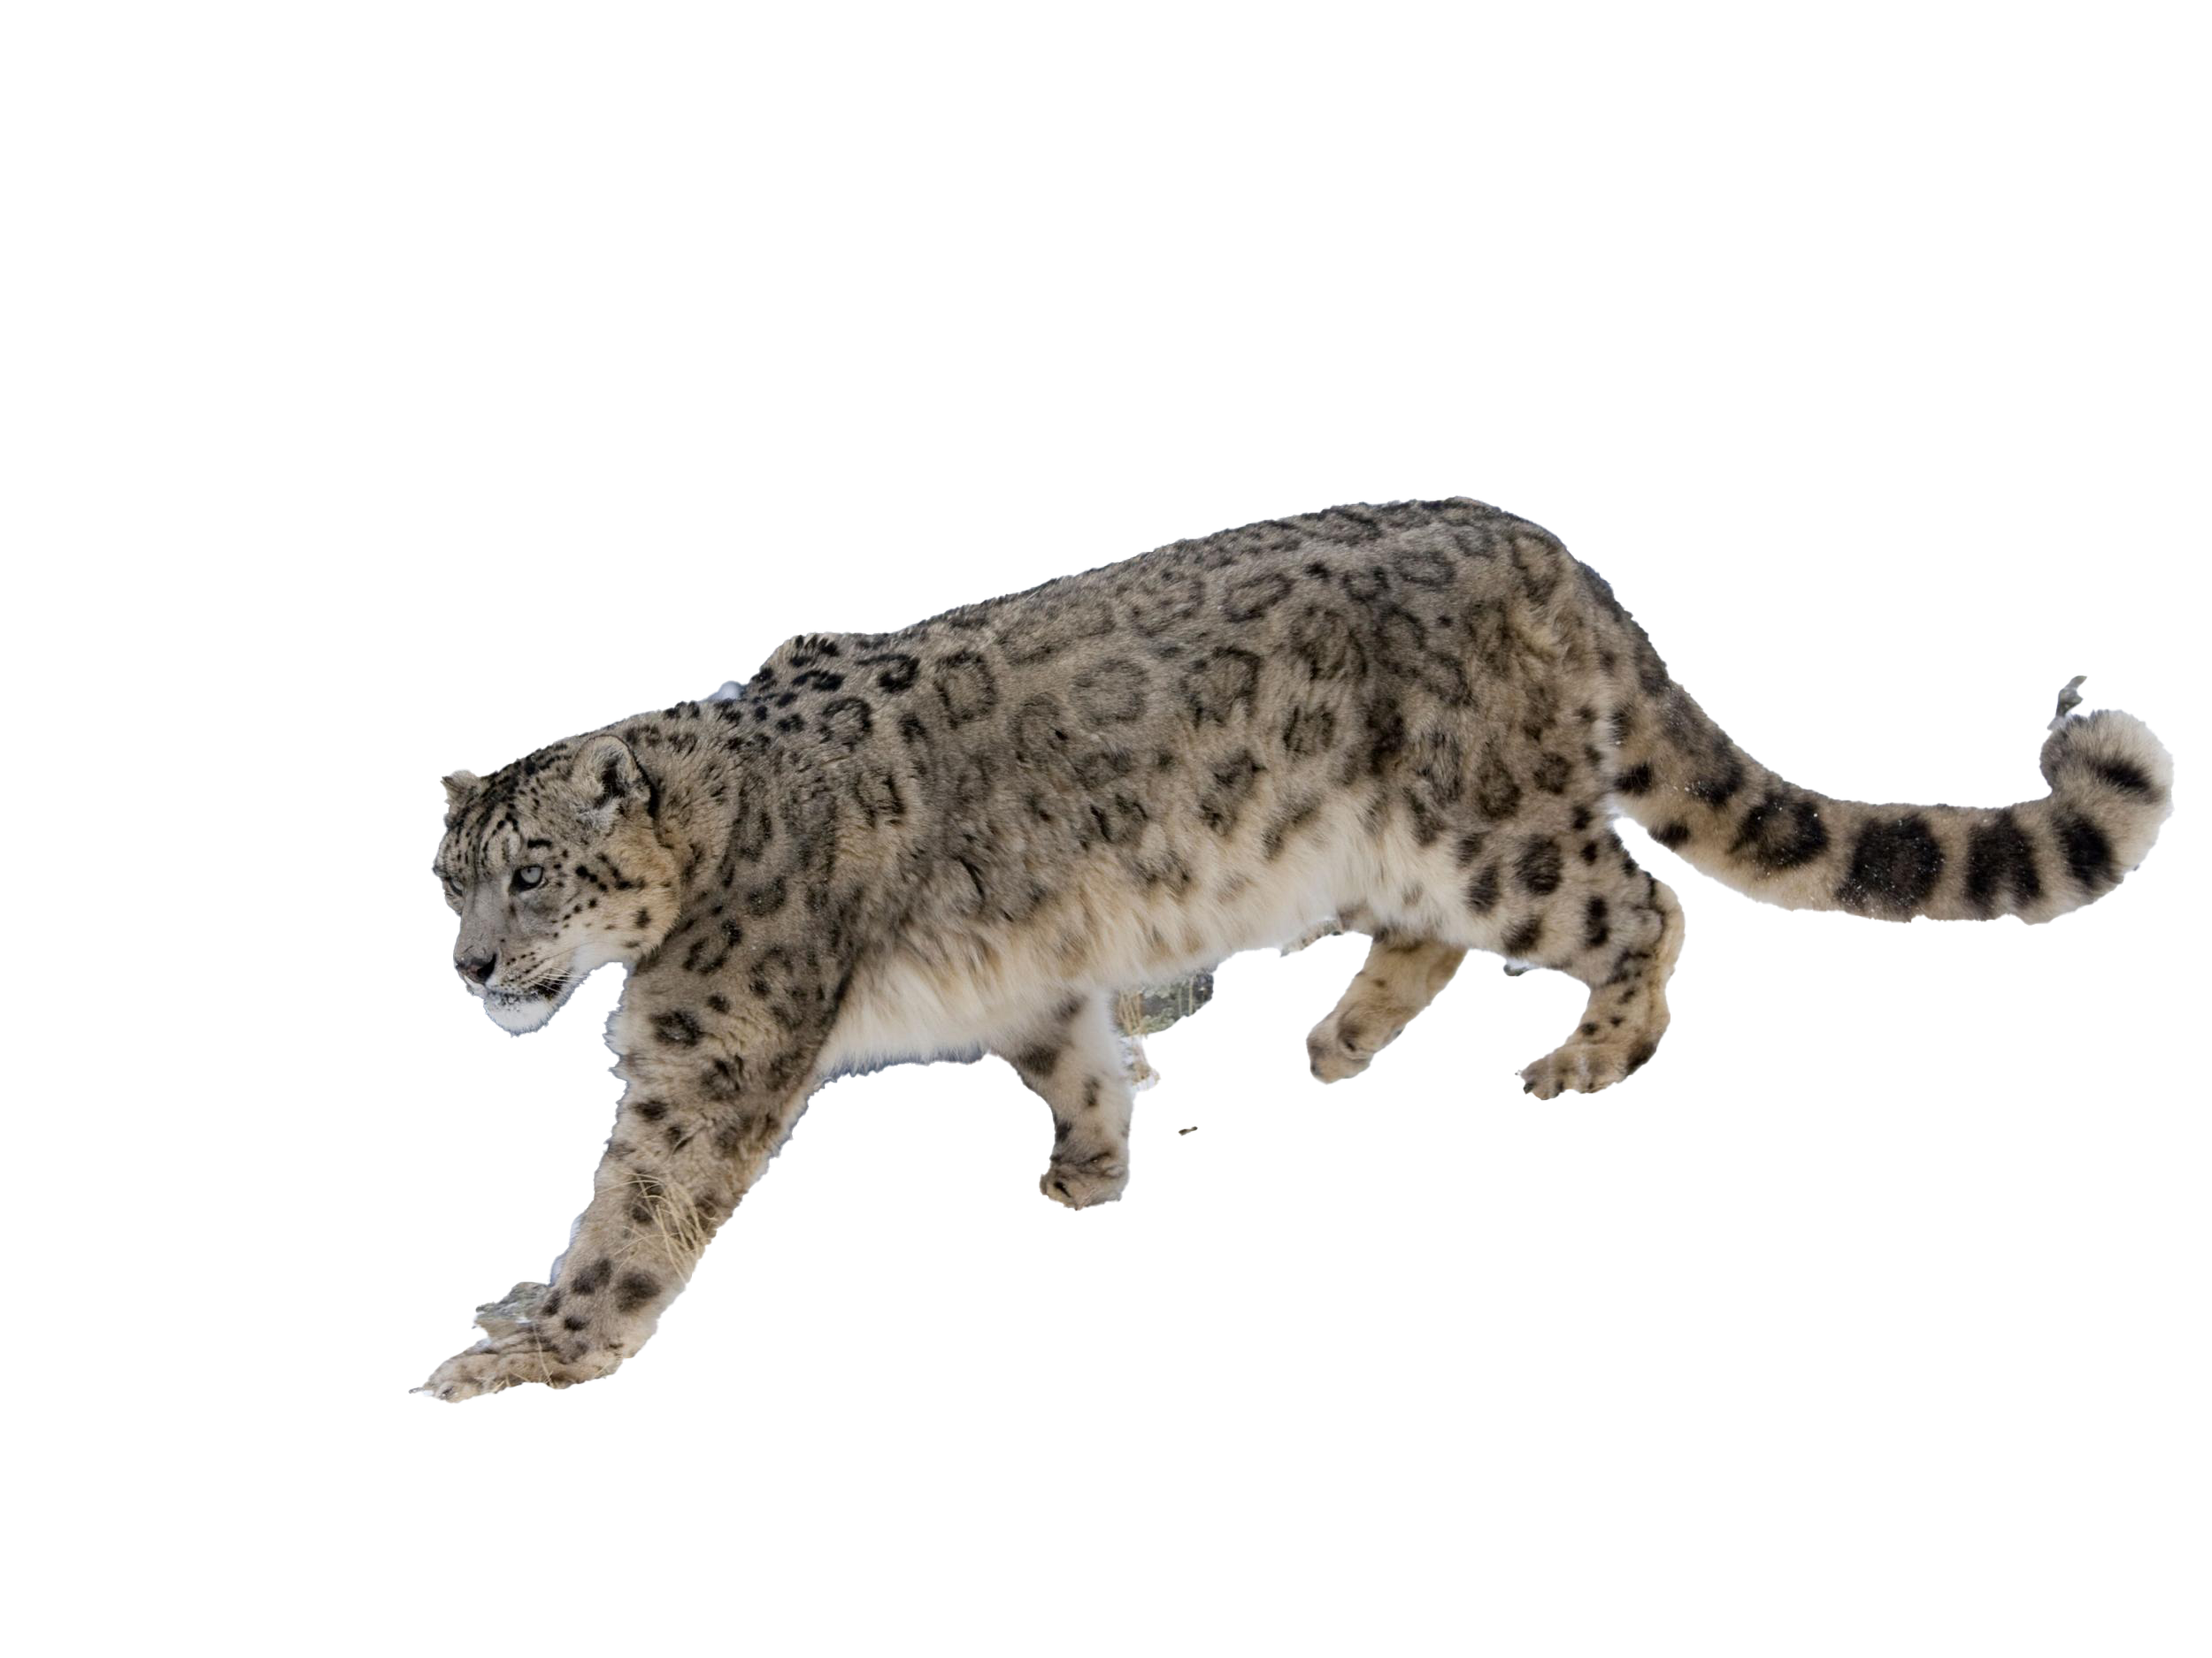
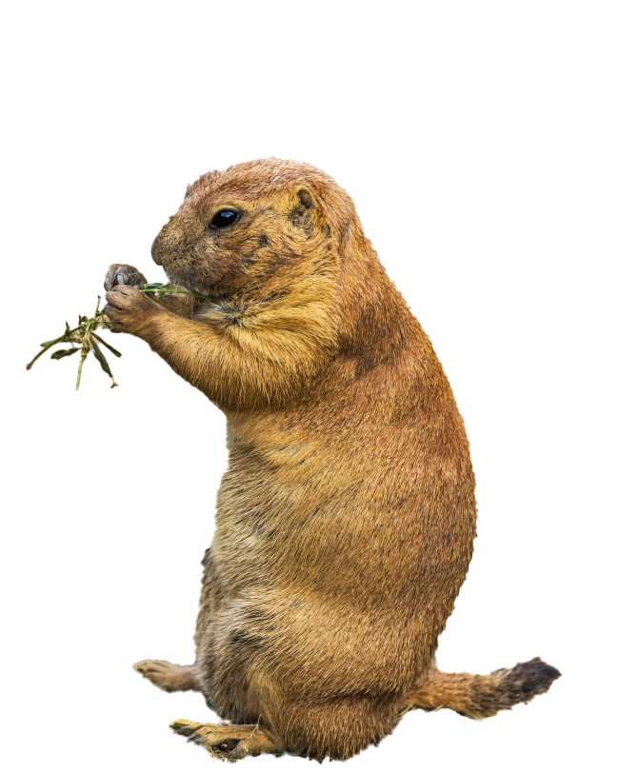
This is a Horizontal parkour game!
Eagle
Snow leopard
Marmot
Link to the game

Slide 3
THANK YOU！

